Slide 1
Salary and Compensation analysis Through Excel data modelling

Slide 2
PROJECT TITLE
SALARY AND COMPENSATION ANALYSIS THROUGH EXCEL DATA MODELING

Slide 3
Agenda
Problem Statement
Project Overview
End users
One solution and description
Dataset Description
Modelling Approach
Results and Discussion
Conclusion

Slide 4
Problem Statement
To analyze the salary and compensation data of employees in order To identify patterns, disparities and areas for Improvement. This analysis Help in making data driven decisions regarding salary adjustment, budget allocations and employees satisfaction Key questions Salary distribution Compensation components

Slide 5
Project Overview
Data collection Data Collection Advance data modelling Reporting and presentation Advance data technics Descriptive Analysis Implementation and follow up

Slide 6
End users
HR manager Department heads Team leaders Board members Financial analysts Individual employees Executive Leadership Finance departments

Slide 7
Solution and proposition
Using Excel for salary and compensation analysis offers several key advantages. First, it allows for detailed and comprehensive analysis of compensation data through advanced functions, pivot tables, and charts, providing deep insights into salary distributions and trends. Second, Excel’s flexibility enables the customization of models and dashboards to suit specific organizational needs, tracking various metrics such as base salaries and bonuses. Additionally, Excel supports scenario forecasting, allowing users to model different compensation scenarios and assess their impacts using tools like data tables and solver. This aids in effective cost management by calculating total compensation expenses and identifying necessary budget adjustments.

Slide 8
Dataset Description
To analyze salary and compensation using Excel 1. Organize Data: Clean and structure data with columns for salaries, bonuses, job titles, etc. 2. Descriptive Stats: Use functions like AVERAGE, MEDIAN, and STDEV. 3. Summarize data by department or job title. 4. Visualizations: Create charts to visualize distributions and trends. 5. Advanced Analysis: Perform regression and correlation analysis to explore relationships. 6. Reporting: Build dashboards and document key findings.

Slide 9
The wow our Solution
1. Collect Data: Gather salary, bonus, and benefit information. 2. Organize Data: Arrange data in Excel with relevant columns. 3. Analyze: Use formulas (e.g., AVERAGE) and pivot tables to understand compensation trends. 4. Model: Perform scenario analysis and what-if scenarios. 5. Report: Create charts and dashboards to present insights.

Slide 10
Modelling Approach
To analyze salary and compensation using Excel, start by gathering and cleaning data on salaries, job titles, and other relevant factors. Organize the data in a table and perform exploratory analysis with pivot tables and charts. Use statistical functions to calculate averages and standard deviations. Apply regression analysis to understand how factors impact salary and use visualizations to present trends.

Slide 11
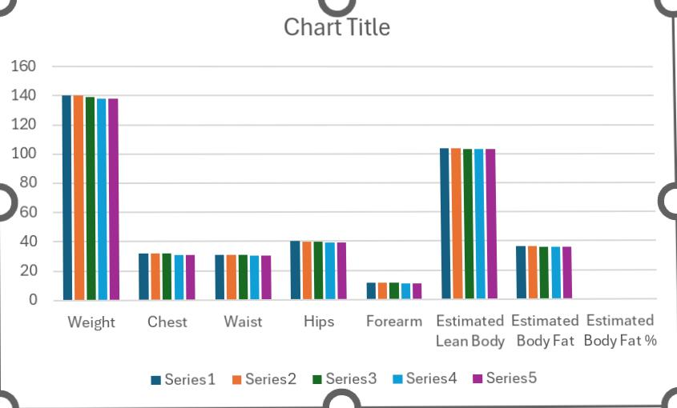
Results

Slide 12
Conclusion
In conclusion, the Excel-based salary analysts revealed key Insights: a skewed salary distribution suggests issues with progression, agender pay gap is evident in senior roles, and some positions are undercompensated compared to industry standards. Additionally, while bonuses are fairly distributed, inconsistencies in non-monetary benefits may impact employee satisfaction. Addressing these areas can enhance fairness, competitiveness, and retention

